Slide 1


Sleep Health in College Students:
A Multivariable Predictive Modeling Analysis
Jonah Watson
Supervisor: Yasser Alginahi
December 8, 2025
Notes:
specify majors

Slide 2
Presentation Content
Introduction & Motivation
Project Overview
Literature Review
Methodology
Model Building & Testing
Results & Discussion
Conclusion & Connection to Ribbons of Excellence
References
Acknowledgements

Slide 3
Introduction & Motivation
Sleep is very important to every single human being, and so learning how to get the most out of sleep is also important
College students balance classes, studying, athletics, working, partying, and other hobbies, jeopardizing sleep quality

Slide 4
Introduction & Motivation
This research serves to raise awareness and expand understanding of what predicts sleep quality
This research also serves to both contribute new findings and reinforce previous findings to further the research on sleep
Personally, I was interested in investigating what improved or diminished sleep quality, especially among college students

Slide 5
Literature Review
A comprehensive review of relevant literature on sleep was created before performing firsthand data analysis
This will be discussed further later in the ”Results & Discussion” section
Main ideas:
  Sleep affects, and is affected by, a large and varied group of factors
  7-9 hours of sleep seems to be the most optimal range for college students (aligns with the healthiest predictors and healthiest consequences of sleep)

Slide 6
Methodology
Data was purchased from the ACHA-NCHA spring 2024 survey (103,639 survey responses from American college students)
The process of working through the data is shown on the next slide
Notes:
Clarify what ACHA-NCHA means

Slide 7
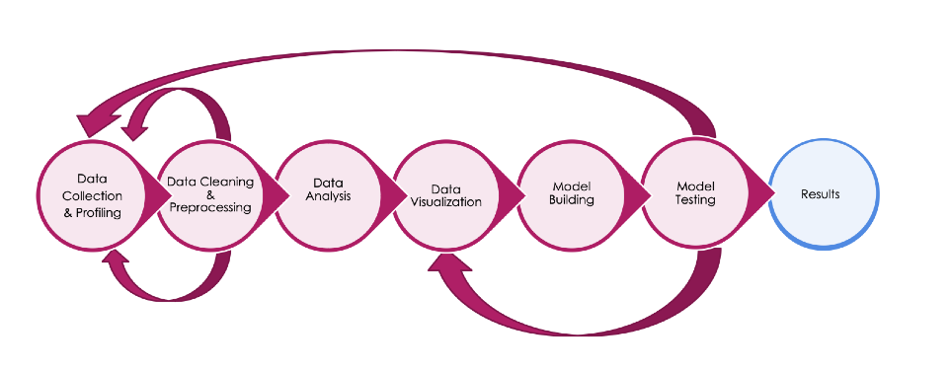
Methodology (Pipeline)
Nearly all of the processes in the pipeline were completed using the Python programming language and its libraries

Slide 8
Methodology
(Data Collection & Profiling)
As previously stated, the data represents 103,639 American college students, representing 154 higher education institutions
Roughly 42 different feature columns were used (around 20 questions total) for demographics and analysis
The next two slides will display tables of the 20 features that were most essential to the upcoming data analysis section

Slide 9
Methodology
(List of Most Important Variables)
Variable | Description
N3Q1 | Self-reported overall health rating
N3Q13 | Average time spent to fall asleep
N3Q14 | Average amount of weeknight sleep (last 2 weeks)
N3Q15 | Average amount of weekend night sleep (last 2 weeks)
N3Q20D | Has the student been a victim of sexual assault? (last 12 months)
N3Q20F | Has the student been a victim of rape? (last 12 months)
N3Q20G | Has the student been a victim of stalking? (last 12 months)
N3Q42B | The student’s ability to bounce back from illness, injury, or hardship (resilience)
N3Q48 | Overall stress level (last 30 days)

Slide 10
Methodology
(List of Most Important Variables Cont’d)
Variable | Description
N3Q65A2 | Has the student been diagnosed with ADD/ADHD?
N3Q65A3 | Has the student been diagnosed with alcohol or drug abuse/addiction?
N3Q65A7 | Has the student been diagnosed with anxiety?
N3Q65A15 | Has the student been diagnosed with depression?
N3Q65A28 | Has the student been diagnosed with insomnia?
N3Q65A35 | Has the student been diagnosed with sleep apnea?
N3Q65Y | How much have the diagnosed conditions affected academics? (last 30 days)
RKESSLER6 | Kessler-6 score for mental distress (0-12 negative for mental distress, 13-24 positive)
RULS3 | UCLA Loneliness Scale (3-5 negative for loneliness, 6-9 positive)
DIENER | Diener Flourishing Scale (8–56; higher = greater well-being)

Slide 11
Methodology
(Data Cleaning & Preprocessing)
Several rounds of data cleaning were performed
These rounds of cleaning included...
  Removal of irrelevant variables
  Removal of duplicate rows
  Recoding of categorial answers into numerical answers (for analysis)
The next two slides will display relevant demographic information

Slide 12
Methodology
(Key Demographics)
Sex | Representation
Female | 72,586 (70.9%)
Male | 29,775 (29.1%)
Average Age | 23.4
Year in School | Representation
Freshman | 20,832 (20.7%)
Sophomore | 17,239 (17.1%)
Junior | 20,600 (20.5%)
Senior | 15,796 (15.7%)
5th+ Year Undergraduate | 4,779 (4.7%)
Master’s Student | 13,646 (13.6%)
Doctorate Student | 8,198 (8.1%)

Slide 13

Methodology
(Data Analysis & Visualization)
This section of the presentation will contain the most relevant findings from exploratory data analysis and visualization
These findings and visualization helped inform the model development and testing, which will be discussed later
The first step in the analysis process was comparing sleeping behaviors, demographics, and other data to pick out prominent correlations

Slide 14
Methodology
(Key Demographics Cont’d)
Race/Ethnicity | Representation
White | 62,857 (60.6%)
Hispanic/Latina/Latino | 19,120 (18.4%)
Asian/Asian American | 17,425 (16.8%)
Black/African American | 6,920 (6.7%)
Biracial/Multiracial | 5,183 (5%)
Other (includes Pacific Islander, Middle-Eastern, etc) | 4,954 (4.8%)
Approximate GPA | Representation
A | 63,718 (63.7%)
B | 29,899 (29.9%)
C | 5,841 (5.8%)
D/F | 551 (0.6%)

Slide 15

Methodology
(Data Analysis & Visualization)
Females take around 7% longer to fall asleep than males
White students slept longest, Black/African American students slept shortest
Time taken to fall asleep increased consistently as GPA decreased (students with an A GPA fell asleep fastest)
Length of sleep decreased consistently as GPA decreased (students with an A GPA slept longest)

Slide 16
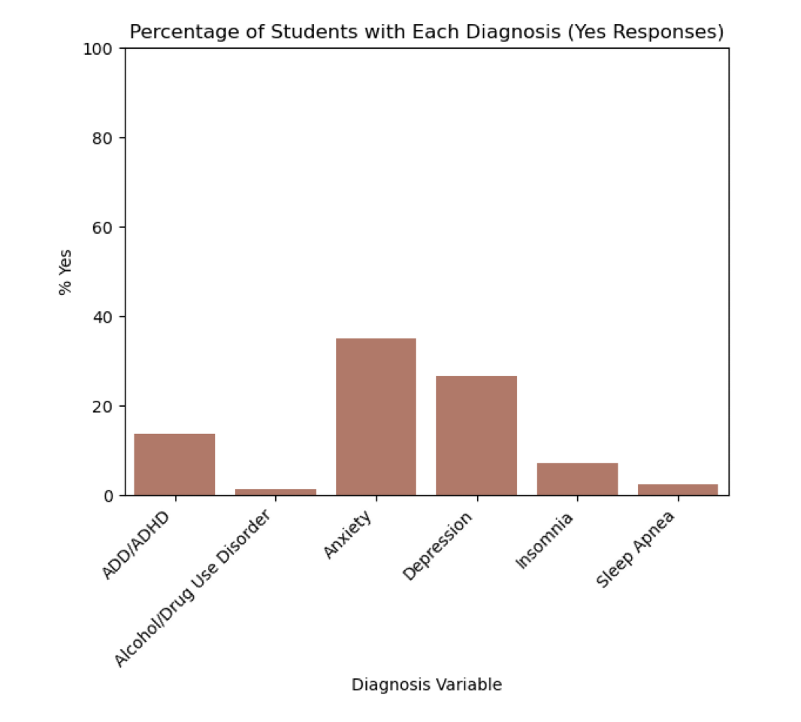
Methodology
(Data Analysis & Visualization)

Slide 17
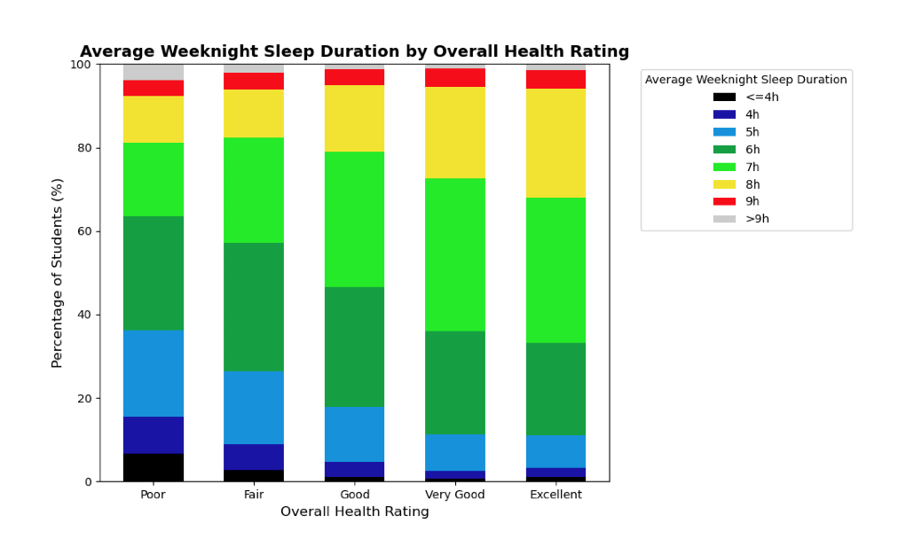
Methodology
(Data Analysis & Visualization)
Notes:
7h-8h is optimal range... 28.8% in poor, 36.8% in fair, 48.4% in good, 58.7% in very good, 60.8% in excellent
Suboptimal range 6h or less... 63.5% in poor, 57.2% in fair, 46.5% in good, 35.8% in very good, 33.2% in excellent

Slide 18
Methodology
(Data Analysis & Visualization)
22% of students reported experiencing negative academic side effects from sleeping difficulties
Students who feel engaged and interested in daily activities are 14% more likely to sleep optimally than students who are not as engaged.
Only 36.7% of students with serious psychological distress get optimal sleep, compared to 55.7% of students without distress.
46.9% of lonely students get optimal sleep, while 56.6% of students who are not lonely achieve optimal sleep.
Notes:
line spacing 1.15 and 12 after for each slide

Slide 19
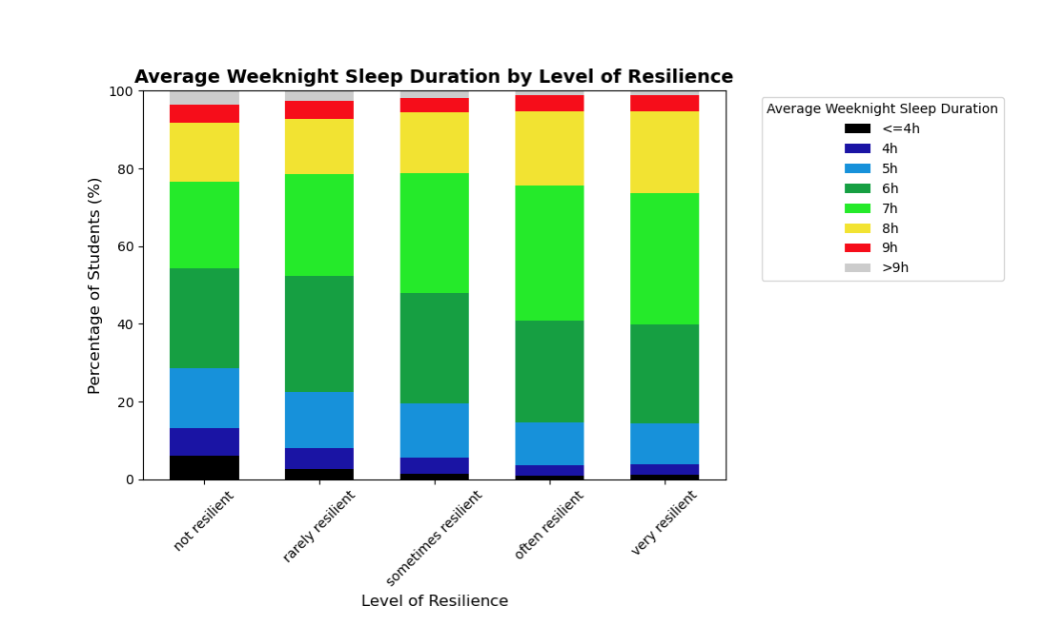
Methodology
(Data Analysis & Visualization)
Notes:
7h-8h is optimal range... 37.7% in not, 40.5% in rarely, 46.3% in sometimes, 53.8% in often, 54.8% in very resilient
Suboptimal range 6h or less... 54.2% in not, 52.4% in rarely, 48% in sometimes, 41% in often, 39.9% in very resilient

Slide 20
Methodology
(Data Analysis & Visualization)
Students with sexual assault trauma get around 15 less minutes of sleep per night than those without
Students with stalking trauma get around 25 less minutes of sleep per night than those without
Students with rape trauma get around 30 less minutes of sleep per night than those without (6h 27m per night vs 6h 57m)

Slide 21
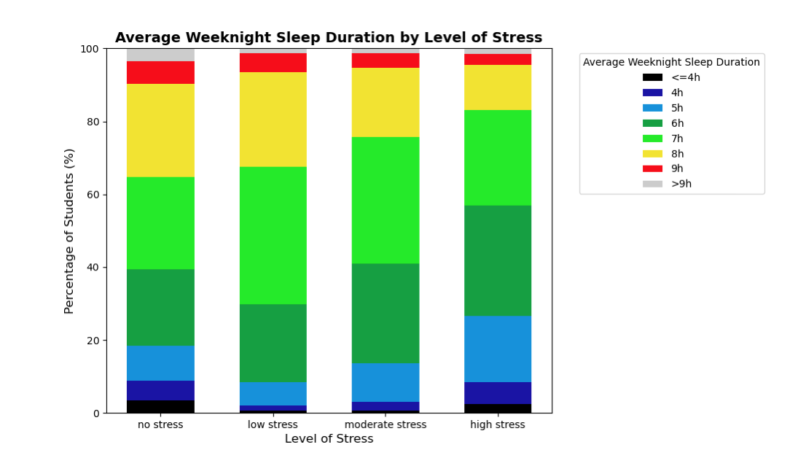
Methodology
(Data Analysis & Visualization)
Notes:
Low stress actually produces better results than no stress
7-8 hours optimal group – 63.7% at low stress vs 38.7% at high stress, whereas 6hrs or less (suboptimal) is around 10% at low stress compared to nearly 30% at high stress

Slide 22
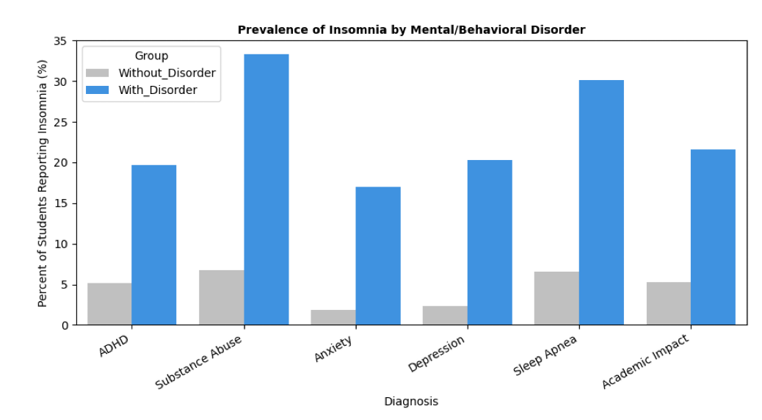
Methodology
(Data Analysis & Visualization)
Notes:
The graph displays the percentage students without each diagnosis who reported insomnia, compared to the percentage of students with that diagnosis who reported insomnia.
So, for example, among students with ADHD, 20% have insomnia and 80% do not, whereas only 5% of students without-ADHD have insomnia.
This indicates that insomnia frequently co-occurs with other mental or behavioral health disorders
Anxiety: Students with anxiety are 9 times more likely to have insomnia
Depression: 8.5 times more likely
Substance: 5 times more likely
Apnea/ADHD/Academic: 4 times more likely

Slide 23
Model Building & Testing
The next step after exploratory data analysis (EDA) and visualization is building and testing a model
The EDA and visualization phase reveals relationships between variables and lays out a foundation to build a more accurate and reliable model

Slide 24
Model Building & Testing
The first model I created was a linear regression model
This predicted the amount of sleep a student got based off their stress level, mental health diagnoses, and other factors
The model was less accurate than I hoped for, so I created another model...

Slide 25
Model Building & Testing
(Logistic Regression)
While linear regression models are focused on predicting, logistic regression models are focused on classifying
My approach pivoted from predicting how much sleep a student gets, to classifying whether a student is an optimal sleeper
To do this, I divided students into two groups:
  Optimal: students who reported getting 7-9 hours of sleep per night on average
  Suboptimal: students who reported getting 6 or less hours of sleep per night on average
Notes:
Talk about hole between 6-7 hours, talk about not including over 9 hours, and talk about why this is “optimal” sleep

Slide 26
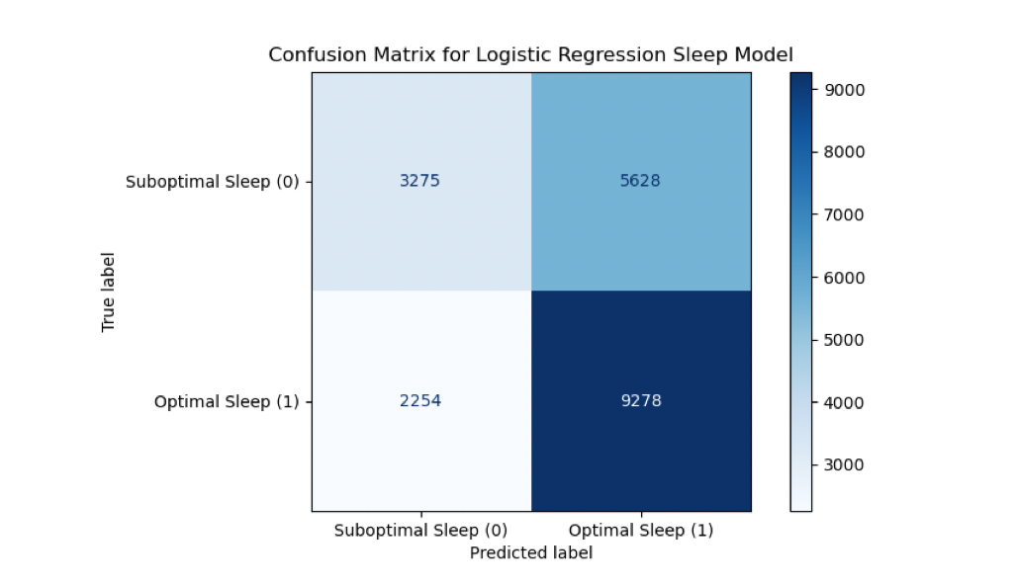
Model Building & Testing
(Logistic Regression)
Notes:
Here we have the data used for testing (20%) – the model had 3,275 true negatives, 5,628 false negatives, 9,278 true positives, and 2,254 false positives
REFER TO THE MODEL BUILDING AND TESTING SECTION OF THE PHYSICAL REPORT FOR FORMULAS AND MORE INFORMATION

Slide 27
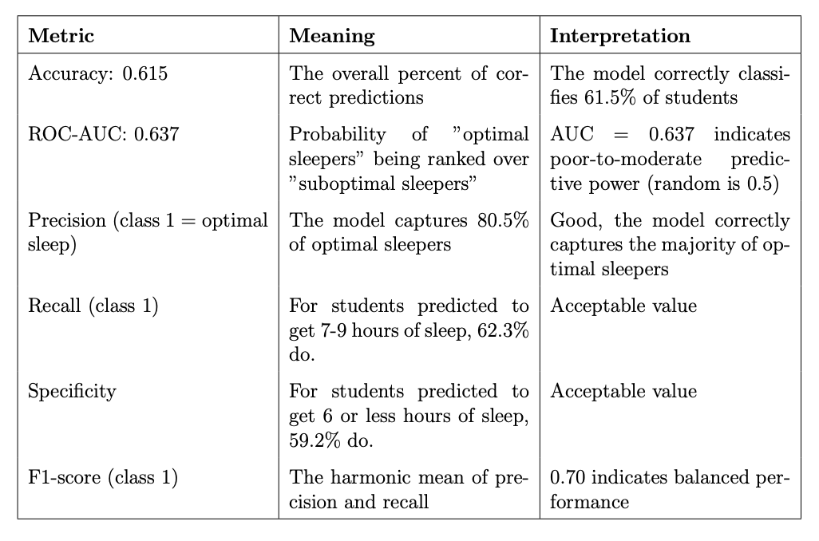
Model Building & Testing
(Logistic Regression)
Notes:
Many of these scores are calculated with the correlation matrix

Slide 28
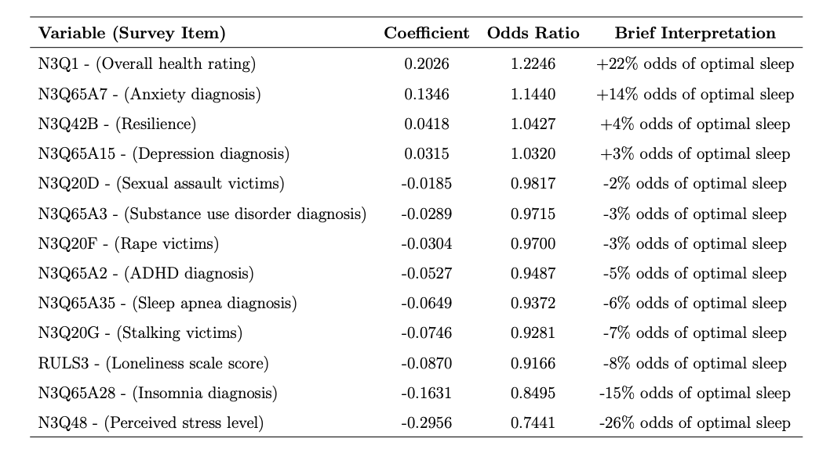
Model Building & Testing
(Logistic Regression)
Notes:
With each increase in stress level (no/low/moderate/high stress), the odds of optimal sleep decrease by 26%.
With each improvement in self-reported overall health rating (poor/fair/good/very good/excellent), the odds of optimal sleep increase by 22%.
An expected relationship was that the odds of optimal sleep were reduced by 15% when diagnosed insomnia was present.
However, an unexpected relationship was the presence of diagnosed anxiety in students showing, 14% higher odds of obtaining optimal sleep

Slide 29
Model Building & Testing
(Additional Testing)
Both a decision tree and a random forest model were also tested
These models are often used to attempt to capture non-linear relationships, where the rate of change is not constant
The decision tree model scored 60.4% accuracy and the random forest model scored 60.1%, compared to the stronger 61.5% from logistic regression
The other metrics were also all similar or weaker to those of the logistic regression model

Slide 30
Results & Discussion
Stress had the strongest negative relationship with optimal sleep
  The idea of how stress affects sleep is reinforced by parallel findings from many previous studies
Insomnia has strong patterns of comorbidity with mental health disorders and a strong negative relationship on sleep
  This idea is reinforced by many studies
Self-reported overall health ratings also had a strong relationship with sleep optimality, a generalized and logical concept

Slide 31
Results & Discussion
The presence of anxiety and depression unexpectedly raised the odds of optimal sleep by 14% and 3%, respectively
  These findings diverge from previous studies and my own analysis, as anxiety and depression were often shown to jeopardize sleep quality
Loneliness, lower resilience, ADHD, substance use, sleep apnea, and traumatic factors all contributed to jeopardized sleep quality
  These findings align with much, if not all the literature reviewed for this study
62% model accuracy indicates that there are many other contributors to sleep duration outside of those included in this study

Slide 32
Conclusion
This study’s focus shifted from a broad examination of sleep quality factors to identifying predictors of optimal vs. suboptimal sleep
Logistic regression (62% accuracy) showed that stress, insomnia, and lower overall health were the strongest negative predictors of optimal sleep
Insomnia showed strong comorbidity with mental health conditions
Key limitations include the data being self-reported and cross-sectional, a lack of variables such as caffeine use and screen time, and missing sleep-duration categories
This study is especially important for students, institutions, and researchers, as it supports efforts for future research and education on stress management, sleep hygiene, and disorder comorbidity

Slide 33
Connection to Ribbons of Excellence
Notes:
Caring for humanity and the world: This project helps improve student well-being by identifying sleep risks which promotes appropriate support and responsible health decisions
Learning throughout a lifetime: This project shows questioning and adaptation in refining and exploring data and research as well as remaining open to new findings
Thinking critically: This project applies analytical reasoning to evaluate predictors, recognize limitations, identify unexpected results, and propose evidence-based solutions
Crossing boundaries and disciplines: This project demonstrates interdisciplinary thinking by merging elements of psychology, public health, statistics, and education
Developing creativity: This project uses creative visualization and model design choices to identify patterns, interpret complex behaviors, and propose innovation in future research

Slide 34
References
T. Deliens, B. Deforche, I. De Bourdeaudhuij, and P. Clarys, “Determinants of physical activity and sedentary behaviour in university students: a qualitative study using focus group discussions,” BMC public health, vol. 15, no. 1, p. 201, 2015.
D. J. Taylor, A. D. Bramoweth, E. A. Grieser, J. I. Tatum, and B. M. Roane, “Epidemiology of insomnia in college students: relationship with mental health, quality of life, and substance use difficulties,” Behavior therapy, vol. 44, no. 3, pp. 339–348, 2013.
P. Upright, T. Esslinger, and W. Hays, “Health issues affecting college student’s academic performance,” Kentucky Association of Health, Physical Education, Recreation and Dance, vol. 51, no. 2, pp. 30–36, 2014.
S. D. Hershner and R. D. Chervin, “Causes and consequences of sleepiness among college students,” Nature and science of sleep, pp. 73–84, 2014.
J. Dinis and M. Bragan¸ca, “Quality of sleep and depression in college students: A systematic review,” Sleep Science, vol. 11, no. 4, pp. 290–301, 2018. [Online]. Available: https://pmc.ncbi.nlm.nih.gov/articles/PMC6361309/
Notes:
For more references, please refer to my report

Slide 35
Acknowledgements
I would like to thank...
My parents, Mike and Leslie Watson, for their consistent support personally, financially, and academically
Dr. Yasser Alginahi, my capstone supervisor, for his guidance, time, and overall support throughout this project
Adrian College, for providing quality learning opportunities such as the Data Analytics capstone class
The ACHA, for providing the dataset used in this study
Seth Logan and Anthony Mollica, my colleagues, for their feedback and company throughout this project
Notes:
THANK EVERYONE FOR COMING
AFTER QUESTIONS, INTODUCE ANTHONY “ “Finding the Net: A Predictive Look at NHL Shooting Performance” – Anthony Mollica”

